Slide 1
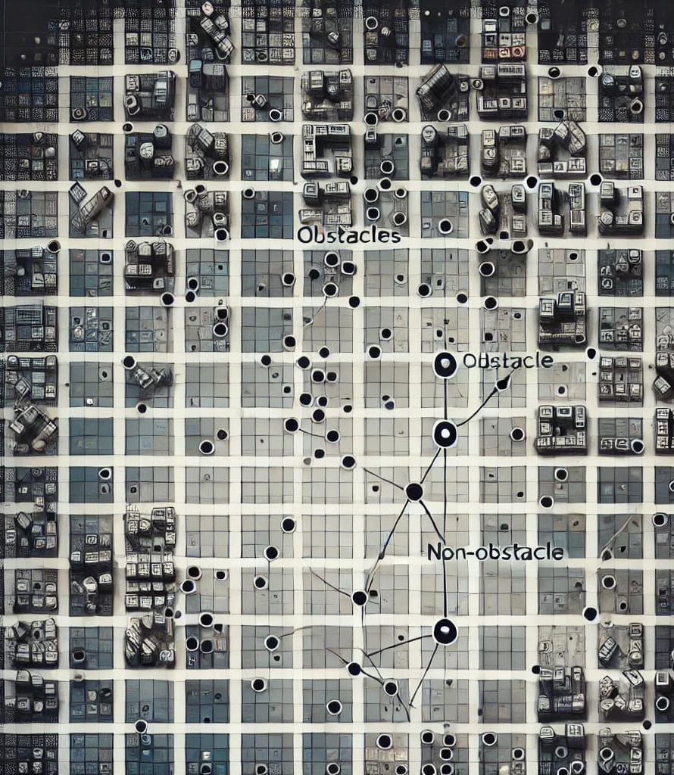
Visibility Learning

Slide 2
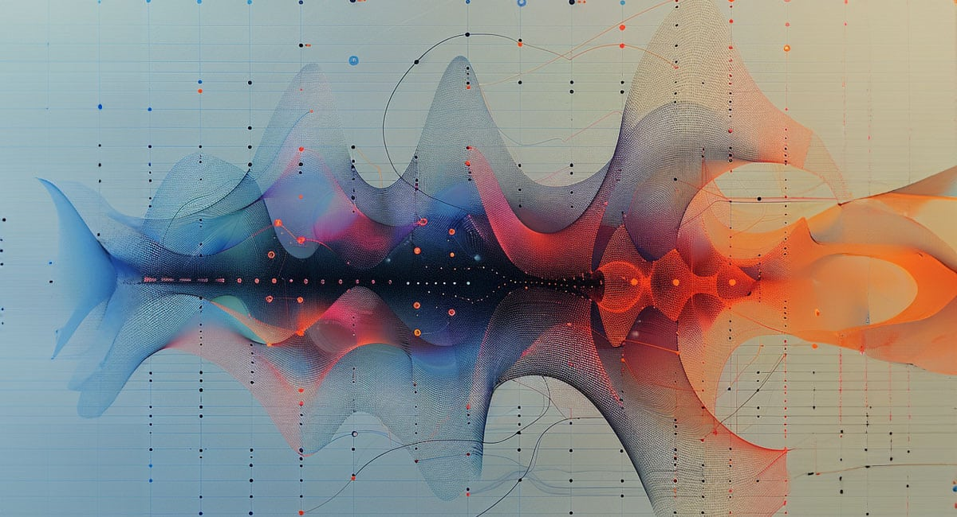
Experimental:
RNN based architecture

Slide 3
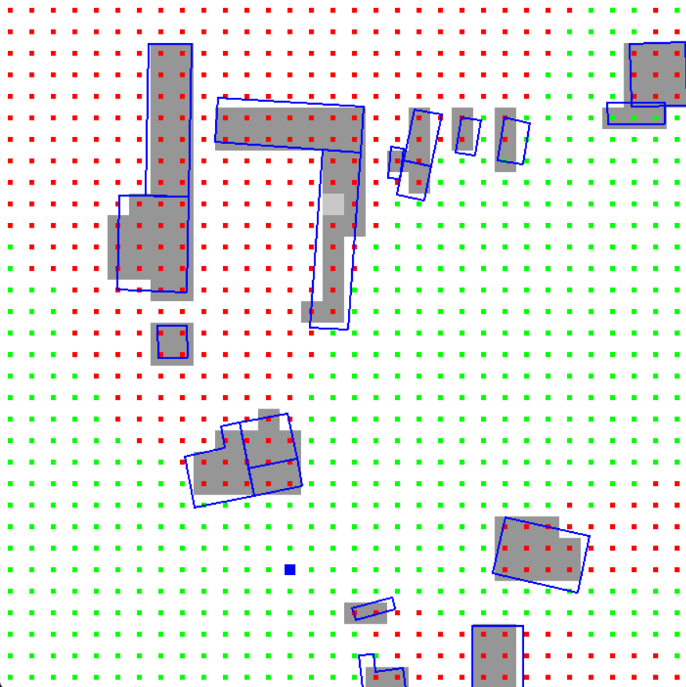
Experimental: RNN based architecture
Motivation:
In our current implementation, we predict visibility between some fixed cells.
Not between any two continuous points

Slide 4
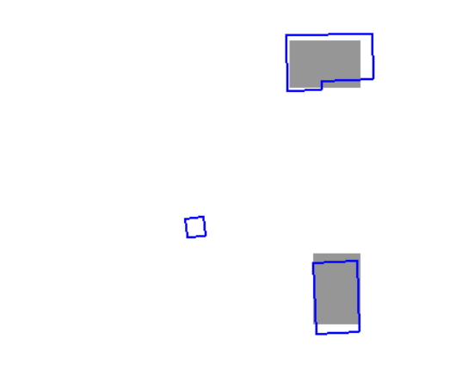
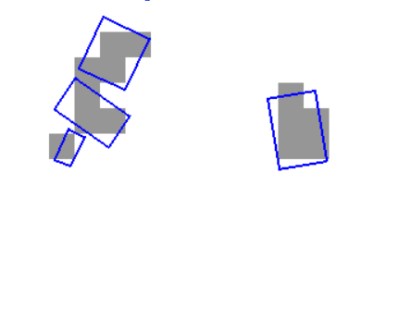
Experimental: RNN based architecture
Motivation:
Scan conversion loses accuracy
Doesn’t create embedding for obstacles smaller than cell
Incorrectly labels visibility in dataset (in our approach of dataset generation)

Slide 5
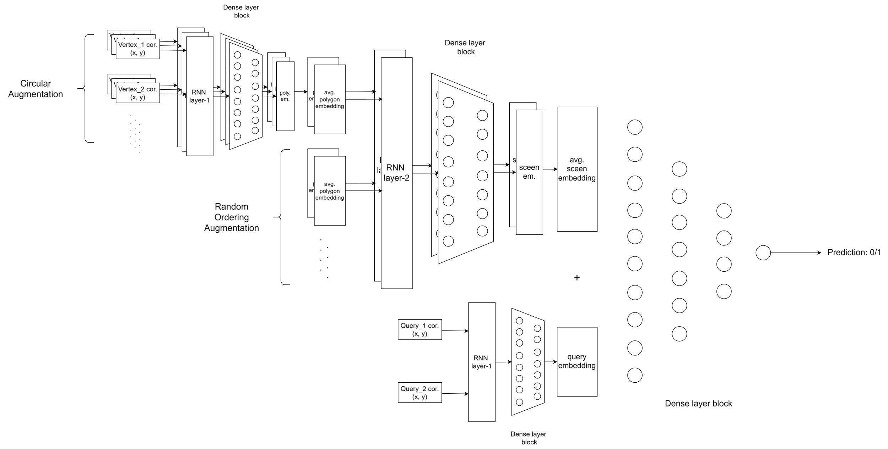
Experimental: RNN based architecture

